Slide 1




PlanIt:
Smart Scheduling Made Simple
Presented by Anthony Abdallah, Romy Matar, Robin Sarhane

Slide 2


OVERVIEW
Meet the Team
Introduction
Project Overview
Key Features
Challenges
Potential Improvements

Slide 3



Meet The Team!
Anthony Abdallah
Romy Matar
Robin Sarhane
02
Backend Developer
Handled the server-side logic, API integrations, and ensured everything runs smoothly behind the scenes.
Frontend Developer
Designed and developed the user interface, making sure the website is interactive, accessible, and visually appealing.
Database Manager
Built and managed the database structure, ensuring data is recognized, secure, and efficiently connected to the application.

Slide 4


Introduction
Students often waste hours trying to manually build a class schedule that fits their needs. The process is frustrating, time-consuming, and prone to errors like overlapping classes or inefficient gaps between courses. Finding the perfect schedule should be easier and faster.
PlanIt is a smart scheduling tool that automatically generates all possible schedules based on the courses a student selects. In just a few clicks, students can explore every valid option, compare them, and choose the schedule that best fits their preferences — saving time, reducing stress, and making academic planning simple.

Slide 5


Project Overview
01 Time-Saving & Efficiency
Instead of manually trying different course combinations, students instantly get all possible schedules, saving them hours of work.
Why Choose PlanIt?
02 Flexibility & Customization
Students can easily compare different schedules to find the best one based on preferred time slots, gaps between classes, or personal commitments.
03 Conflict-Free Scheduling
The system ensures that all generated schedules avoid time conflicts, helping students register without worrying about overlapping classes.

Slide 6

Project Overview
Results
How does it work?
01
Select your Courses
Begin by choosing the courses you want to take for the upcoming semester.
02
Generate All Possible Schedules
The website will automatically calculate all possible combinations of schedules based on the available courses.
03
Choose your Ideal Schedule
Once you find the schedule that works best for you, select it to finalize your semester plan. Don’t forget to save it, so you can come back to it later on.

Slide 7
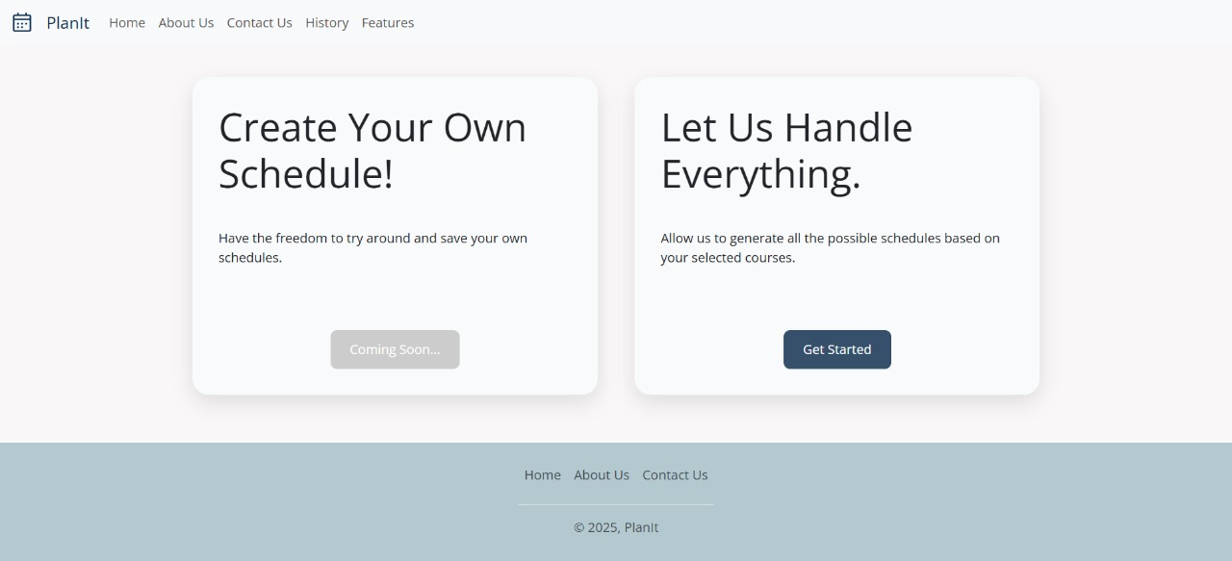
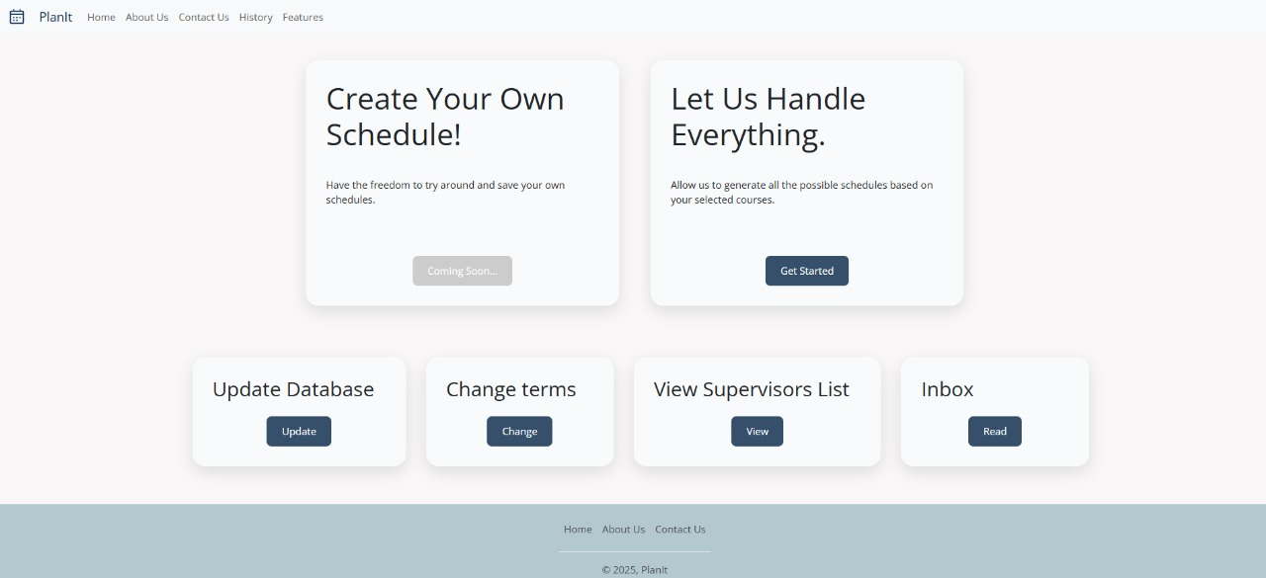
Key Features
Our platform offers two types of login: Regular User and Supervisor. Regular users can easily generate schedules, manage their selections, and access personal account features for a smooth experience.
Supervisors have enhanced access with additional features, including updating the course database, changing academic terms, viewing and managing the list of supervisors and communications through an inbox. This separation ensures better system control and organization.

Slide 8
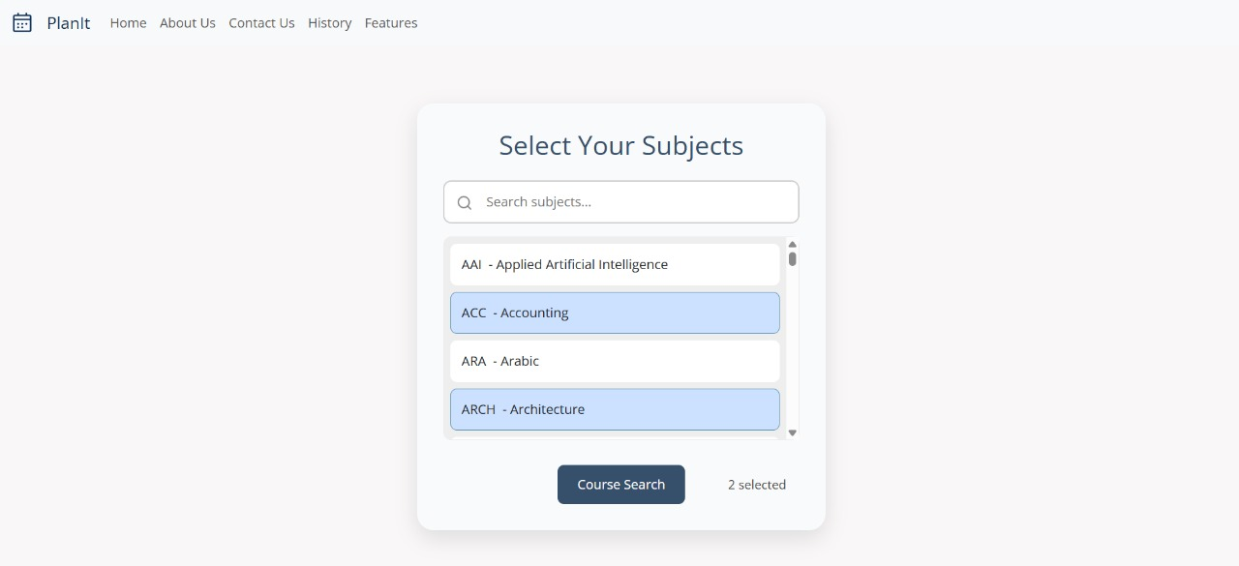
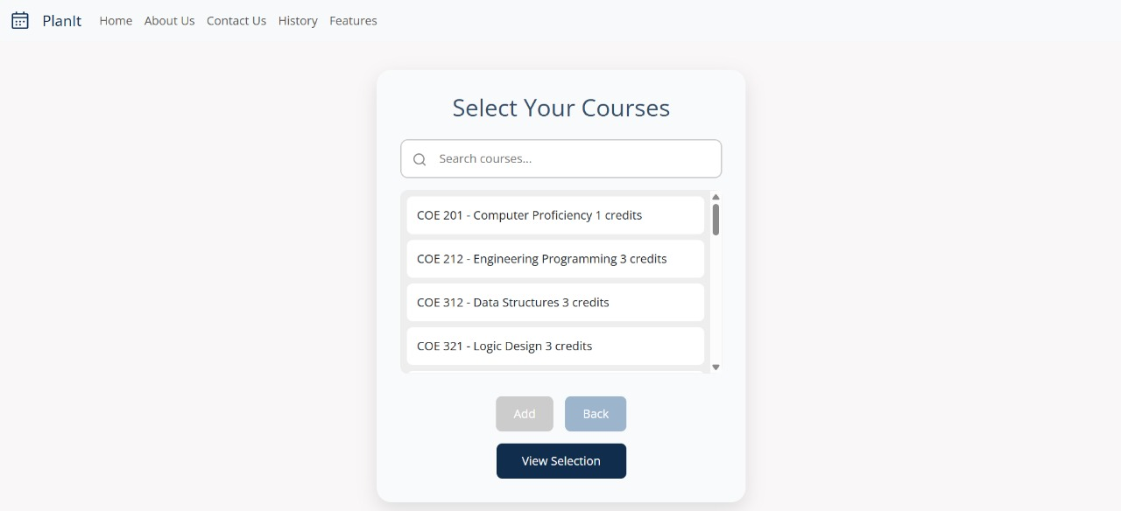
Key Features
Easily search for subjects using the search bar, with real-time filtering as you type.
Click to select or deselect courses, with updates on the number of selected subjects.
Submit your selected subjects for further processing, with the option to review and modify your choices before confirming.
After searching for selecting your subjects, start selecting your courses.
You can always go back if you change your mind.

Slide 9
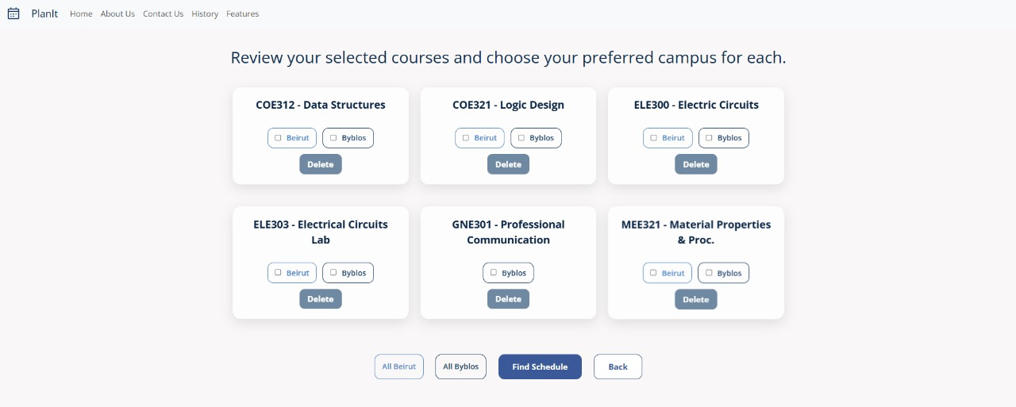
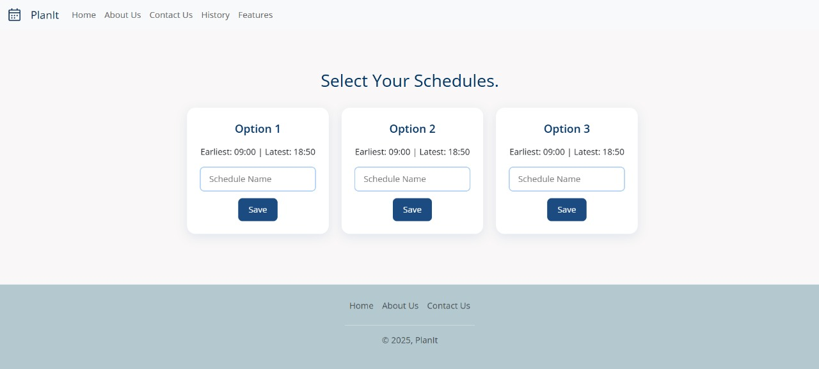
Key Features
The user can now review their selected courses and specify their preferred campus location—Jbeil, Beirut, or both. This ensures that the final schedule matches the user's location preferences before finding the schedules.
Users can view the earliest and latest times of each generated schedule. They have the option to name their preferred schedule and save it for future reference, with the ability to save up to 10 schedules. This allows for easy management and quick access to their chosen timetables later.

Slide 10
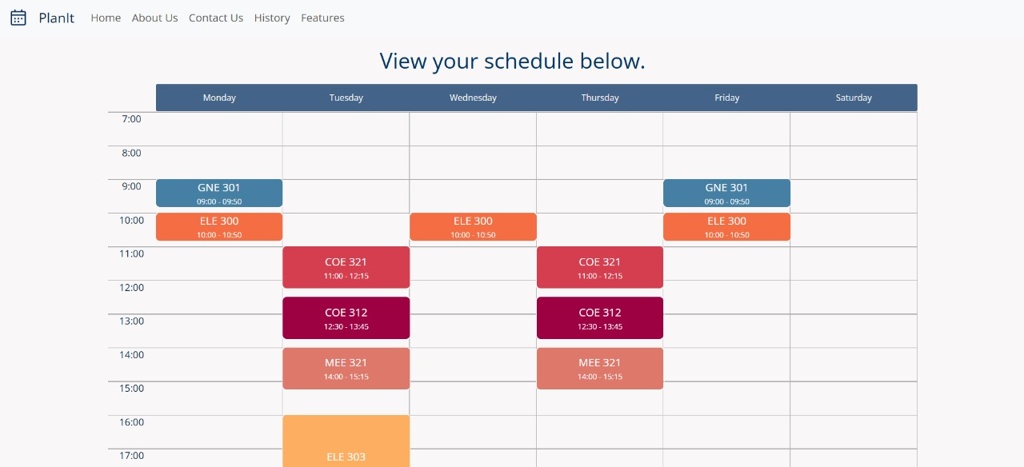
Key Features
Finally, users can see their complete schedule displayed in a clear and organized format, making it easy to review their course timings and ensure everything is in place for the semester.

Slide 11
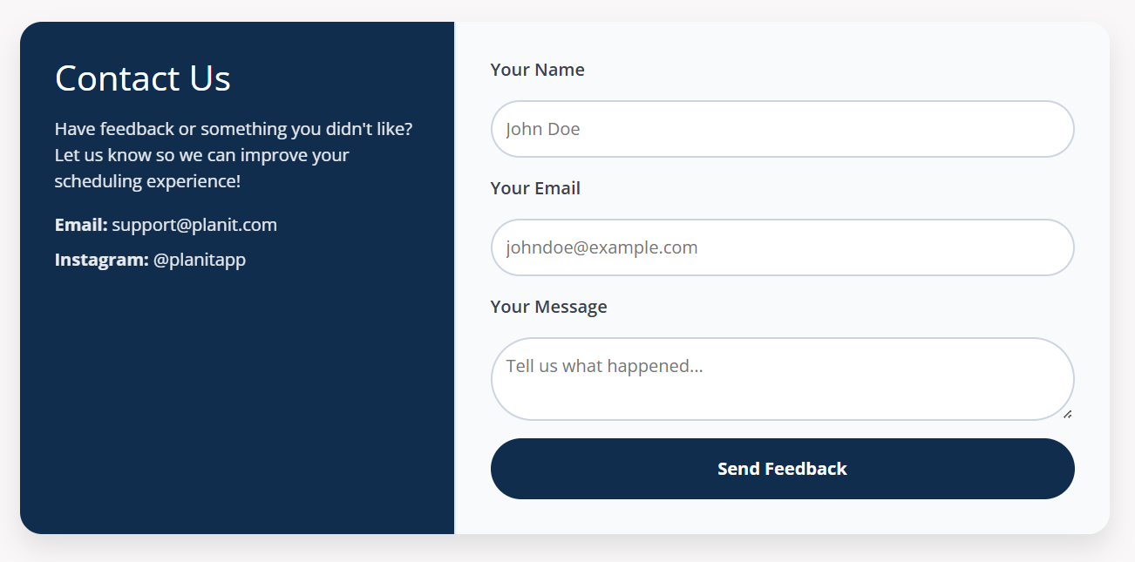
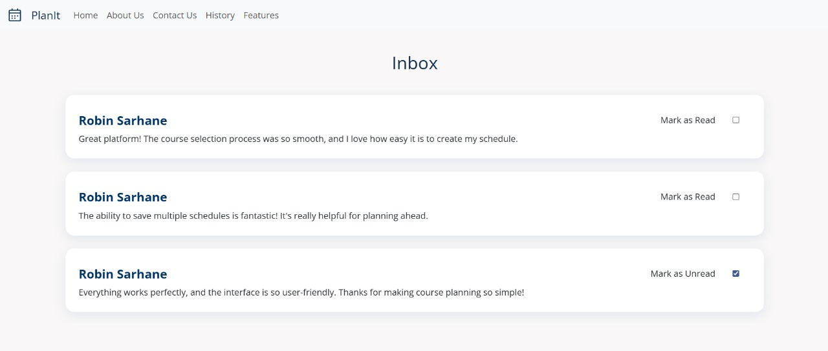
Key Features
Quickly send us your feedback or concerns using a simple form that collects your name, email, and message.
After submitting your message, you'll receive an acknowledgment confirming your feedback has been received.
The Inbox page is exclusively accessible to supervisors, where they can view messages sent from the users. Supervisors can easily check the status of each message, seeing whether it has been marked as read or unread, ensuring efficient management of communication.

Slide 12


Challenges that were overcome
Logical complexity of schedule generation.
Ensuring speed and accuracy of generated schedules.

Slide 13



Potential Improvements
Enhanced Filtering Options
More granular filters (e.g., specific days, instructors, duration, class size, ratings)
Developed Login Options
“Remember me” feature and “Forgot password” feature
Custom Schedule Generation
Let users generate their own schedule
History Access of Previous Terms
Access and review schedules from previous terms for better future planning.
.
Update Courses from University Website
Automatically sync course data from the university’s website for real-time updates.
AI-Powered Personalized Study Plan
AI generates a customized study plan based on schedule, preferences, and goals.
Collaborative Scheduling
Share and collaborate on schedules with friends or classmates
Save as PDF or Local Files
Allow users to save their schedules and plans as PDF files or to local storage for offline access

Slide 14
THANK YOU!
For your attention

